Slide 1

Body Stress Detection Using Machine Learning Techniques
Under the Guidance of
Aarthi Priya.R, Asst Prof
Department of Information Technology
B V Raju Institute of Technology, Narsapur
B.Rajeshwari : 17211A1211
B.Rohan Kumar : 17211A1212
D.Sai Bhargav : 17211A1220
K.Sai Teja : 17211A1238

Slide 2
*
Abstract
Abstract
Introduction
Existing System
Proposed System
Software/Hardware Requirements
Algorithm
Datasets
References
Stress is commonly defined as a feeling of strain and pressure which occurs from any event or thought that makes you feel frustrated, angry, or nervous. In the present situation, many people have succumbed to stress especially the adolescent and the working people. Stress increase nowadays leads to many problems like depression, suicide, heart attack, and stroke. The current technology, using Galvanic skin response (GSR), Heart rate variability (HRV), and Skin temperature are being used individually to detect stress.
In this project data set is created using five features age, gender, body temperature, heartbeat, and blood pressure, and four stages of labels are used for detecting the level of stress.

Slide 3
Abstract
Introduction
Existing System
Proposed System
Software/Hardware Requirements
Algorithm
Datasets
References
Introduction
A person’s standard of living is significantly affected by his emotional states such as stress and anxiety.
According to S. Palmer, ”Stress is often described as a complex psychological and behavioral state resulting from the perception of a significant imbalance between the demands placed on the individual and their perceived ability to meet these demands”.
Stress affects both mental and physical health by causing problems such as abnormalities in the cardiac rhythm i.e. arrhythmia and depression.
Many research were undertaken to elicit and detect stress, based on a person’s physiological parameters. A situation can be stressful when something psychological, such as persistent worry about losing a job, approaching work deadline, etc., happens.

Slide 4
Abstract
Introduction
Existing System
Proposed System
Software/Hardware Requirements
Algorithm
Datasets
References
Introduction
The objective of the proposed work is to automatically detect the stress condition of an individual by using the physiological data recorded. Such a detection can help in monitoring stress to prevent dangerous stress-related diseases.

Slide 5
Abstract
Introduction
Existing System
Proposed System
Software/Hardware Requirements
Algorithm
Datasets
References
Existing System
Existing systems were designed to detect stress by taking tweets as input from the Twitter or Facebook data set and machine learning algorithms are applied to detect stress from tweets.
Disadvantages:
Most of the existing system works were on social networking stress data not on body-based sensor data.
Stress level is calculated based on tweets posted by users.

Slide 6
Abstract
Introduction
Existing System
Proposed System
Software/Hardware Requirements
Algorithm
Datasets
References
Proposed System
The proposed system is designed by collecting and preparing data set on five features (temperature, heartbeat, age, male or female). Using this data set machine learning
Techniques like Logistic Regression, K-Nearest Neighbour(KNN), Support Vector Machine, Random Forest algorithm is applied using and the model is saved. Front end web application is designed to collect new user features and passed them to the model to predict stress stages.
Advantages:
Data is trained using machine learning which helps automate the process of stress detection.
The web applications can help users to easily check their stress state based on their features.

Slide 7
Abstract
Introduction
Existing System
Proposed System
Software/Hardware Requirements
Algorithm
Datasets
References
Software/Hardware Requirements
Operating system: Windows XP/7/10
Coding Language: Html, JavaScript, Python
Development Kit: Flask Framework
IDE: Anaconda prompt
Dataset: Stress dataset
2/10

Slide 8
Abstract
Introduction
Existing System
Proposed System
Software/Hardware Requirements
Algorithm
Datasets
References
Algorithm
SVM is a Support Vector Machine:
In SVM, each data point is plotted in an n-dimensional space (n is the number of features) with the value of each feature being the value of a particular coordinate. The classification is done by finding a hyper-plane that differentiates the classes the best.
k-NN (k-Nearest Neighbors)
In k-NN classification, an object is classified by a majority vote of its neighbours, with object assigned to the class that is the most common among its k-nearest neighbors, where k is a positive integer, typically small. The output of the algorithm is a class membership.
Logistic Regression
It predicts the output of a categorical dependent variable. Therefore the outcome must be a categorical or discrete value. It can be either Yes or No, 0 or 1, true or False, etc. but instead of giving the exact value as 0 and 1, it gives the probabilistic values which lie between 0 and 1.
2/10

Slide 9
Abstract
Introduction
Existing System
Proposed System
Software/Hardware Requirements
Algorithm
Datasets
References
Algorithm
Random Forest
Random Forest is a classifier that contains a number of decision trees on various subsets of the given dataset and takes the average to improve the predictive accuracy of that dataset.
2/10

Slide 10
Abstract
Introduction
Existing System
Proposed System
Software/Hardware Requirements
Algorithm
Modules
References
Modules
Data collection: Gathering the data set in an excel sheet with five features age, gender, temperature, heartbeat, and this data is applied for machine learning, and a model is created.
Data pre-processing:Data is preprocessing by standard scalar function and new features and labels are generated.
Training and Testing: In this stage, data is sent to the testing and training function and divided into four parts x test train, and y test train.
Predict data: New data is taken as input and trained models are loaded using pickle and then values are preprocessed and passed to predict function to find out a result which is shown on the application.
2/10

Slide 11
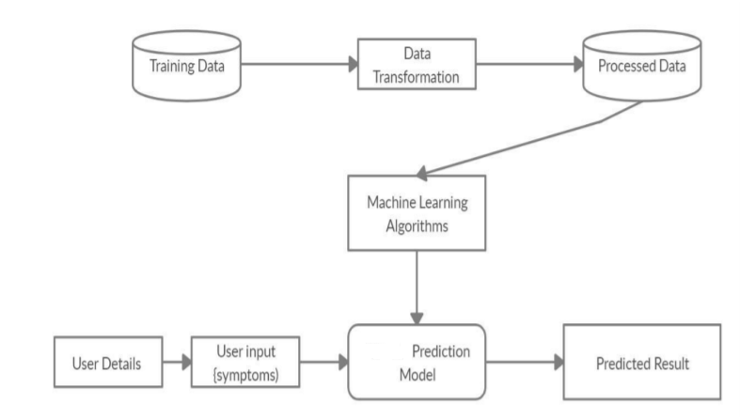
Abstract
Introduction
Existing System
Proposed System
Software/Hardware Requirements
Algorithm
Modules
References
Architecture
2/10

Slide 12
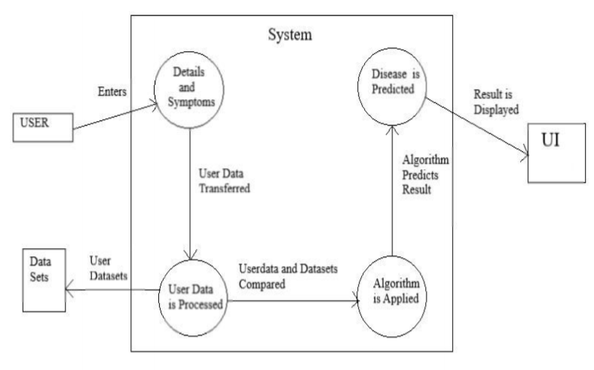
Abstract
Introduction
Existing System
Proposed System
Software/Hardware Requirements
Algorithm
Modules
References
Data Flow Diagram
2/10

Slide 13
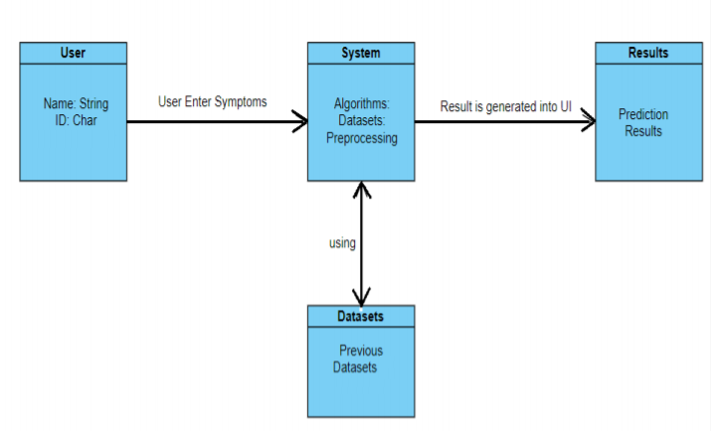
Abstract
Introduction
Existing System
Proposed System
Software/Hardware Requirements
Algorithm
Modules
References
Class Diagram
2/10

Slide 14
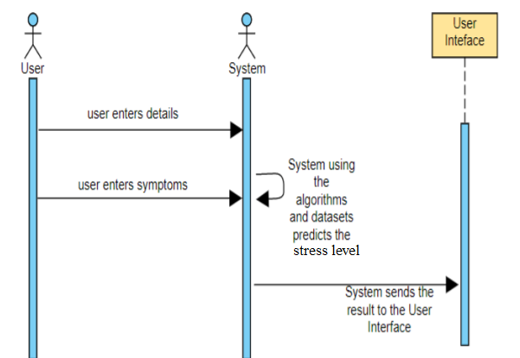
Abstract
Introduction
Existing System
Proposed System
Software/Hardware Requirements
Algorithm
Modules
References
Sequence Diagram
2/10

Slide 15
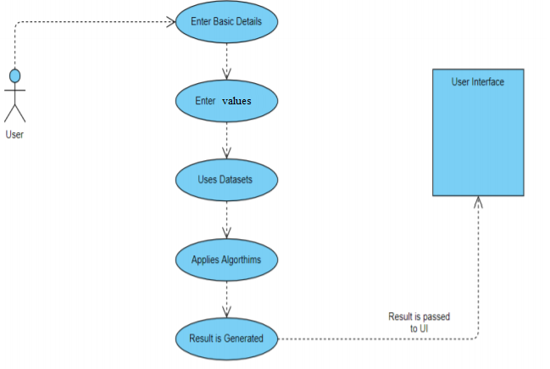
Abstract
Introduction
Existing System
Proposed System
Software/Hardware Requirements
Algorithm
Modules
References
User Case Diagram
2/10

Slide 16
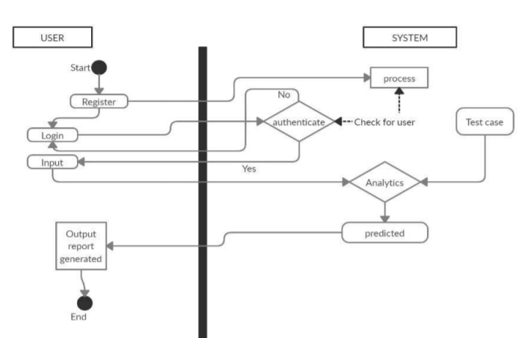
Abstract
Introduction
Existing System
Proposed System
Software/Hardware Requirements
Algorithm
Modules
References
Activity Diagram
2/10

Slide 17
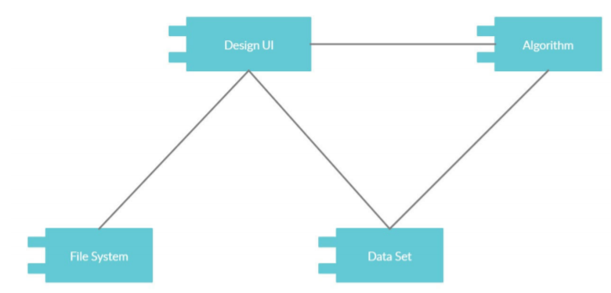
Abstract
Introduction
Existing System
Proposed System
Software/Hardware Requirements
Algorithm
Modules
References
Component Diagram
2/10

Slide 18
Abstract
Introduction
Existing System
Proposed System
Software/Hardware Requirements
Algorithm
Datasets
References
References
Huijie Lin, Jia Jia, JiezhonQiu, “ Detecting stress based on social interactions in social networks”, IEEE Transactions on Knowledge and Data Engineering, 2017.
Mike Thelwall TensiStrength, “Stress and relaxation magnitude detection for social media texts”, Information Processing & Management Science direct, 2017.
Huayang Xie, Peter Andreae, Mengjie Zhang, Paul Warren, “Detecting Stress in Spoken English using Decision Trees and Support Vector Machines”, The New Economy Research Fund, New Zealand, 2004
Munmun De Choudhury, Michael Gamon, Scott Counts, Eric Horvitz, “Predicting Depression via Social Media”, Seventh International AAAI Conference on Weblogs and Social Media, 2013.

Slide 19
Abstract
Introduction
Existing System
Proposed System
Software/Hardware Requirements
Algorithm
Datasets
References
References
Huijie Lin, Jia Jia, JiezhonQiu, “ Detecting stress based on social interactions in social networks”, IEEE Transactions on Knowledge and Data Engineering, 2017.
Mike Thelwall TensiStrength, “Stress and relaxation magnitude detection for social media texts”, Information Processing & Management Science direct, 2017.
Huayang Xie, Peter Andreae, Mengjie Zhang, Paul Warren, “Detecting Stress in Spoken English using Decision Trees and Support Vector Machines”, The New Economy Research Fund, New Zealand, 2004
Munmun De Choudhury, Michael Gamon, Scott Counts, Eric Horvitz, “Predicting Depression via Social Media”, Seventh International AAAI Conference on Weblogs and Social Media, 2013.

Slide 20
Q and A?
?

